Slide 1
A NOVEL PREDICTIVE ANALYSER FOR DATA INTENSIVE APPLICATION
15BCE0076 – VIGNESH VAIDYANATHAN
15BCE0082 – VOLETI RAVI
15BCE0093 – SAMUDRA BORKAKOTI

Slide 2
ABSTRACT
Using a model to map amino acid and sequences of primary structure present in the data set we want to predict the secondary structure of protein. This can be achieved using a bi-directional recurrent neural network (RNN) using Long-short term memory (LSTM), with the convolutional filters and the hidden states providing an input for the next state.
Keywords — Recurrent neural network, Long-short term memory

Slide 3
INTRODUCTION
The secondary structure prediction is a set of techniques which predicts the local secondary structures of protein by knowing only their amino acid sequences. The prediction generally consists of assuming certain regions of the amino acids likely to be α helices and β sheets or coils.
Modern approaches for predicting secondary protein structures makes use of various machine learning methods. New deep learning methods has surfaced and has resulted in good performance. Also people have now moved to analysing homologous proteins which has a better and non-repetitive protein sequences.
Recent architectures use feed-forward neural networks for the predictions from the forward and backward networks in the bidirectional model [1].
We have incorporated a variation of the newly emerging methods using neural network to train our model using bi-directional Recurrent Neural Network (RNN) with memory cells such as, Long-Short Term Memory (LSTM) cells which is will be explained in the coming sections.

Slide 4
APPLICATIONS OF PROTEIN STRUCTURE PREDICTION
Predicted models are used for drug screening using homology modeling in well understood systems.
There is a lot of importance in structure prediction as a screening process for proteins that are not tenable for experimental determination.
These tools can be used for protein engineering. It is going to reach a level of accuracy where one can predict a structure and use that to design increased or reduced affinity to binding partners without the need for an experimental structure.
People may also want to model genetic variation into a protein structure, from site-directed mutations to large insertions and deletions, to predict the structural, and by extension, the biological effects of those variants.

Slide 5
LITERATURE SURVEY
Protein Secondary Structure Prediction with Long Short Term Memory Networks [1] (Søren Kaae Sønderby, Ole Winther)
The contribution of this paper is the application of bidirectional LSTM networks to protein secondary structure prediction. The model architecture uses feed-forward neural networks for concatenation of predictions from the forward and backward networks in the bidirectional model and the model also includes feed-forward neural networks between hidden states in the recurrent network.
Artificial Intelligence in Prediction of Secondary Protein Structure Using CB513 Database [2](Prof.Dr.Sci.Zikrija Avdagic, Mr.Sci.Elvir Purisevic, Mr.Sci.Samir Omanovic, Pharma D.Zlatan Coralic)
The aim is to use the modified API_EPE to evaluate the protein set to predict the secondary protein structure using non - homologous data set. This paper describes CB513 a non-redundant dataset, suitable for development of algorithms for prediction of secondary protein structure. Learning (training and testing) of neural network is researched with different sizes of windows, different number of neurons in the hidden layer and different number of training epochs, while using dataset CB513.

Slide 6
LITERATURE SURVEY(contd.)
Protein and Secondary Structure Prediction with Convolutions and Vertical-Bi-Directional RNNS [3] (Alexander Rosenberg Johansen, Søren Kaae Sønderby, Ole Winther)
A recurrent neural network with memory cells, such as the long-short term memory (LSTM) cell, can inform the model about earlier data in a sequence, thus utilizing the sequential structure. Further the local sequence typology has a high importance for predicting secondary protein structures (Ole cite).
Protein secondary structure prediction using logic-based machine learning [4] (Stephen Muggleton, Ross D.King and Michael J.E. Sternberg)
Predictions are carried out using only local information -- long range interactions are not taken into account. Long range interactions are important -- when a protein folds up, regions of sequence which are linearly widely separated become close spatially. Established approaches have involved hand-crafted rules by experts and Bayesian statistical methods. Golem is an ILP program. It takes positive examples, negative examples and background knowledge (Prolog facts) as input.

Slide 7
PROBLEM STATEMENT
There are about 400 times more protein sequences than protein structures. Finding alternative ways to predict a protein structure becomes more challenging as this gap increases.
The rate at which new protein sequences are being discovered is increasing rapidly, as a result the dataset has doubled over a few decades thereby making computation more complex.
Current technology for protein structure prediction relies on using unknown sequences of proteins and overlaying them with homologous proteins with known structure. Such practice is faulty as it does not account for proteins which do not have a homologous protein in their database.

Slide 8
PROPOSED METHODOLOGY
The neural network divides the sequenced data into three convolutional layers with different filter sizes using batch normalization.
This data condensed into a dense layer acts as an input for RNN with LSTM cells working in forward direction.
The output form this layer is concatenated and passed down as input for RNN with LSTM cells working in backward direction.
We use batch normalization again with different filter sizes to generate only the data that fits out model.

Slide 9
PROPOSED METHODOLOGY(contd.)
Output of the last layer generates many unwanted productions of protein structure that are dropped in the Dropout layer.
The last layer is the Softmax layer that will be used to provide the probability of secondary structure generated in the sequence.

Slide 10
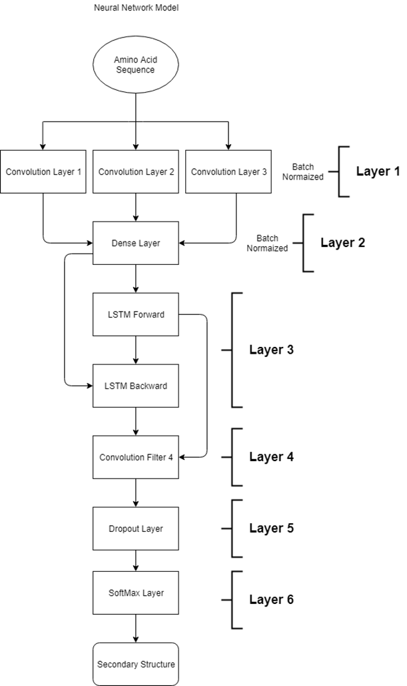
Neural network model

Slide 11
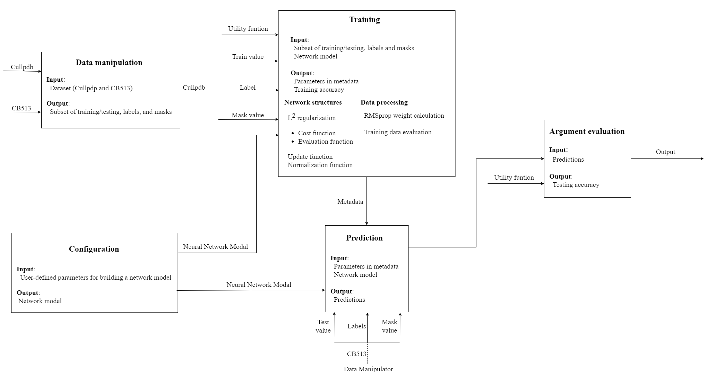
System Block Diagram

Slide 12
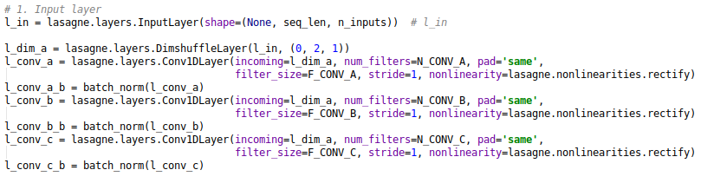
IMPLEMENTATION
Module 1 – Layer 1
InputLayer holds a symbolic variable that represents a network input. DimshuffleLayer rearranges the dimension of its input tensor, maintaining the same total number of elements. This is necessary for convolution filter.
Conv1DLayer performs a 1D convolution on its input and optionally adds a bias and applies an elementwise nonlinearity. The output of this module creates a tensor of 3 dimensions based on user-defined filters.
The ConcatLayer concatenates multiple inputs along the specified axis. The input for this layer is the filtered values from Conv1DLayer. The dimensions are reshuffled back and concatenated with initial input.

Slide 13

IMPLEMENTATION
Module 1- layer 2
A ReshapeLayer reshapes its input tensor to another tensor of the same total number of elements. This is necessary to increase the size of dimension for 3 convolution filters. DenseLayer forms a fully connected layer (number of units provides hidden states) based on the input list given.

Slide 14
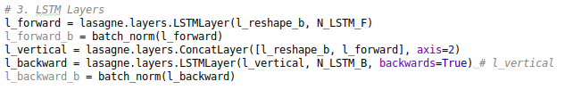
IMPLEMENTATION
Module 2 – layer 3
To construct bi-directional recurrent layers, LSTMLayer is used which includes optional “peephole connections” and a forget gate. It creates forward and backward networks with vertical links.
The forward and backward networks are concatenated to form the overall tensor layer after LSTM.

Slide 15
IMPLEMENTATION
Module 3 – layer 4
The overall tensor layer is reshaped to fit the batch size based on the required output dimensions for the dropout and Softmax layers.
Layer 5
A DenseLayer is created from the dropout of the tensor layer which sets values to zero with probability p.
Layer 6
Again, a DenseLayer is created from the tensor layer using Softmax activation function. This activation function gets applied row-wise
Finally, the output layer is created by reshaping the tensor layer to the required based on the batch size and number of classes.

Slide 16

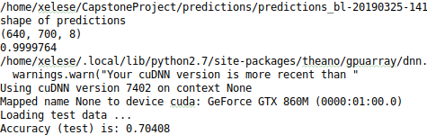
RESULTS
Without CNN, vertical links and batch normalization
With CNN, vertical links and batch normalization

Slide 17
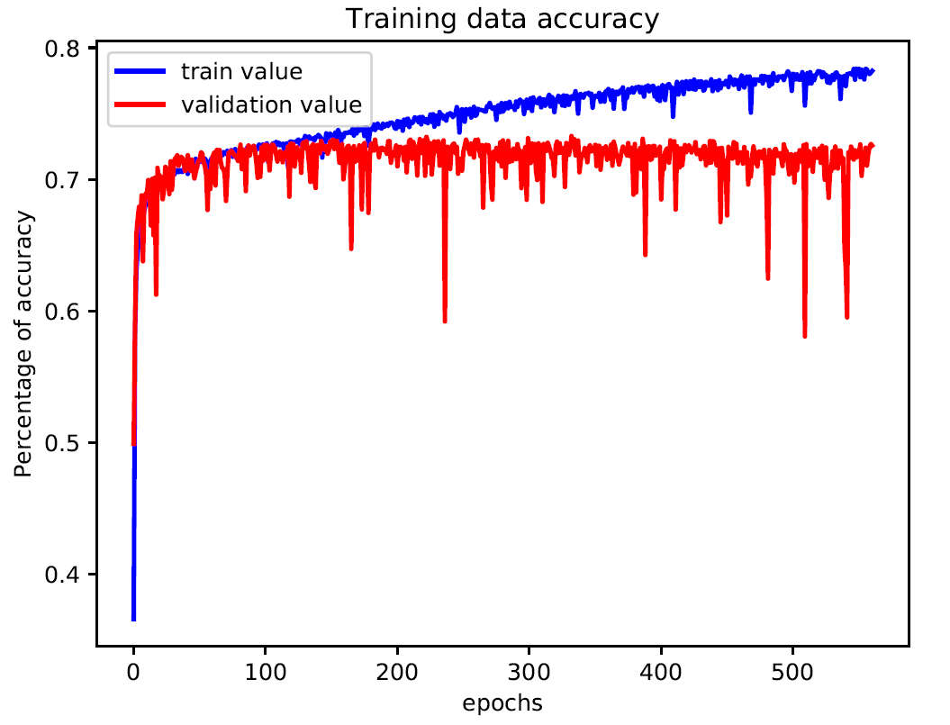
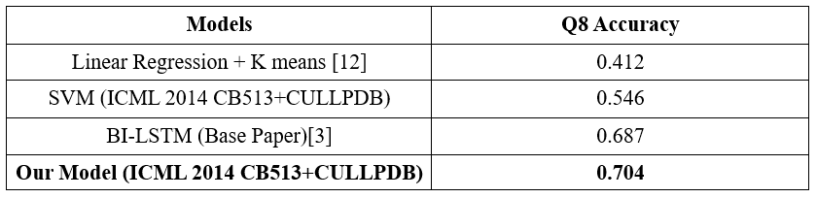
RESULTS(contd.)
Training and validation accuracy
Comparison of Q8 accuracy between Different methods

Slide 18
CHALLENGING ISSUES IDENTIFIED AND ADDRESSED
The manipulation of the parameters involved seems to have an effect in the accuracy of the prediction.
Therefore, it is necessary to try out different parameters in order to find the best fit for highest possible accuracy.
Adding and removing of filters also seems to have an effect in the accuracy of the prediction. With the addition of certain filters, the accuracy seems to drop. Therefore, we suspect that the filters are removing some necessary data along with the unnecessary ones.
This can be solved by analysing the effects of each filter size on the physical data and manipulating them accordingly.

Slide 19
SUMMARY
Prediction of protein secondary structure from primary structure has been an active research area in hierarchical approach to the protein-folding problem.
The application works just as expected and by incorporating the features suggested in the survey and adding our own additional filters and tuned parameters and have obtained an accuracy of 70.4% in our prediction.
The amount of non-homogenous dataset available is limited. There are many task-dependent variables in the training process that makes its distribution difficult. This results in longer computation time.
Every established approaches have involved handcrafted rules by experts and Bayesian statistical methods. A variety of machine learning methods have been applied along with neural networks and symbolic induction. Comparison between different methods is difficult because different types of proteins used in their datasets.
The limitations of this project comes down to the accessibility of the dataset. The current dataset that we have used is proper for models like RNN and LSTM but not for classifiers such as SVM, Linear Regression and K means clustering. Thereby yielding a poor result.

Slide 20
REFERENCES
[1] Søren Kaae Sønderby and Ole Winther. Protein secondary structure prediction with long short term memory networks. arXiv preprint arXiv:1412.7828, 2014.
[2] Zikrija Avdagic, Prof.Dr.Sci Elvir Purisevic, Mr.Sci Samir Omanovic, Mr.Sci. Zlatan Coralic, Artificial Intelligence in Prediction of Secondary Protein Structure Using CB513 Database. 2009
[3] Alexander Rosenberg Johansen, Søren Kaae Sønderby, Ole Winther. Protein and secondary structure prediction with convolutions and Vertical-bi-directional rnns. 2016
[4] Stephen Muggleton, Ross D.King and Michael J.E. Sternberg. Protein secondary structure prediction using logic-based machine learning. vol.5 no.7 pp.647-657, 1992
[5] Jian Zhou and Olga G Troyanskaya, “Deep supervised and convolutional generative stochastic network for protein secondary structure prediction,” arXiv preprint arXiv:1403.1347, 2014.
[6] Sheng Wang, Jian Peng, Jianzhu Ma, and Jinbo Xu, “Protein secondary structure prediction using deep convolutional neural fields,” Scientific reports, vol. 6, 2016.

Slide 21
THANK YOU

